Slide 1

8th Grade Math: Pre-Algebra
Unit 5, Lesson 4 The Triangle Inequality Theorem and the Converse of the Pythagorean Theorem Volume 1, pg. 190

Slide 2


Benchmark
MA.8.GR.1.3
Use the Triangle Inequality Theorem to determine if a triangle can be formed from a given set of sides. Use the converse of the Pythagorean Theorem to determine if a right triangle can be formed from a given set of sides.
volume 1, pg. 190

Slide 3
Integrated Mathematical Thinking and Reasoning Standards
MA.K12.MTR.1.1 Actively participate in effortful learning both individually and collectively.
MA.K12.MTR.4.1 Engage in discussions that reflect on the mathematical thinking of self and others.
MA.K12.MTR.5.1 Use patterns and structure to help understand and connect mathematical concepts.
volume 1, pg. 190

Slide 4

Learning Targets
I can use the Triangle Inequality Theorem to determine if a triangle can be formed from a given set of sides.
I can use the converse of the Pythagorean Theorem to determine if a right triangle can be formed from a given set of sides.
volume 1, pg. 190

Slide 5

Warm-Up
volume 1, pg. 190

Slide 6
5.4.1 Warm-Up: Notice and Wonder
A square and two right triangles are shown.
What do you notice about the square and the two triangles?
What do you wonder about the square and the two triangles?
volume 1, pg. 190

Slide 7

Exploration
volume 1, pg. 191

Slide 8

5.4.2 Exploration: Triangle Inequality Theorem
You will receive five different lengths of string, paper, or straw for this activity.
Attempt to make three different triangles on your desk using different sizes for the sides.
Measure each side and record the lengths in the table. Indicate if the chosen side lengths formed a triangle or not.
Attempt | Side Length 1 | Side Length 2 | Side Length 3 | Triangle Formed?
A |  |  |  | Yes No
B |  |  |  | Yes No
C |  |  |  | Yes No
volume 1, pg. 191

Slide 9
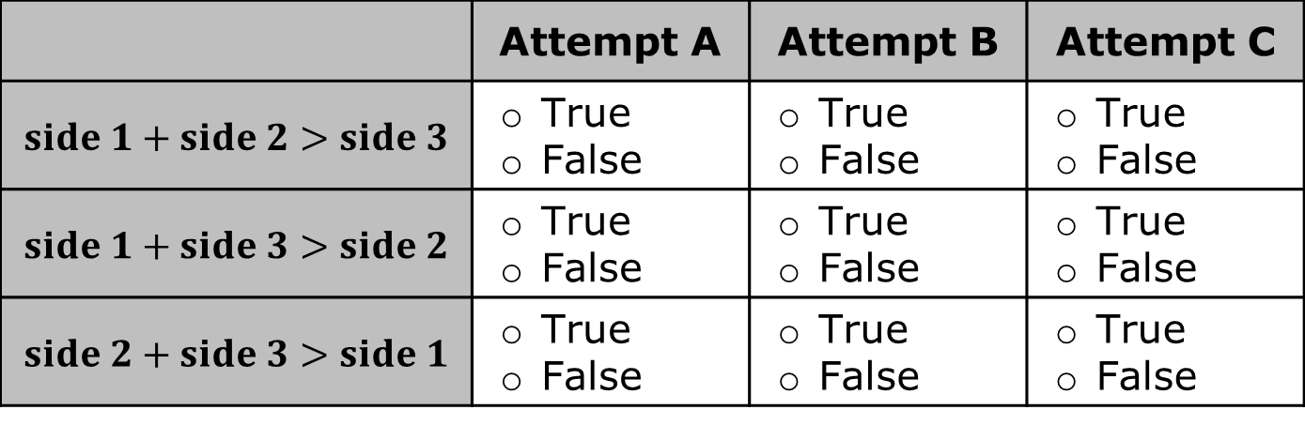
For each attempt, compare the sum of two side lengths to the length of the third.
Record the results in the table.
 | Attempt A | Attempt B | Attempt C
$$side 1+side 2>side 3$$ | True False | True False | True False
$$side 1+side 3>side 2$$ | True False | True False | True False
$$side 2+side 3>side 1$$ | True False | True False | True False
volume 1, pg. 191

Slide 10
Complete the statements.
When the chosen side lengths formed a triangle, the side length comparisons were
When the chosen side lengths did not form a triangle, the side length comparison were
all true.
all false.
not all true.
all true.
all false.
not all true.
volume 1, pg. 191

Slide 11

Triangle Inequality Theorem
The sum of the lengths of any two sides of a triangle is greater than the length of the third side.
Draw a picture to show what happens when the length of the third side of a triangle is not longer than the sum of the other two sides.
volume 1, pg. 191

Slide 12

Guided Instruction
volume 1, pg. 192

Slide 13

5.4.3 Guided Instruction: Converse of the Pythagorean Theorem
Use the grid to complete the steps.
volume 1, pg. 192

Slide 14
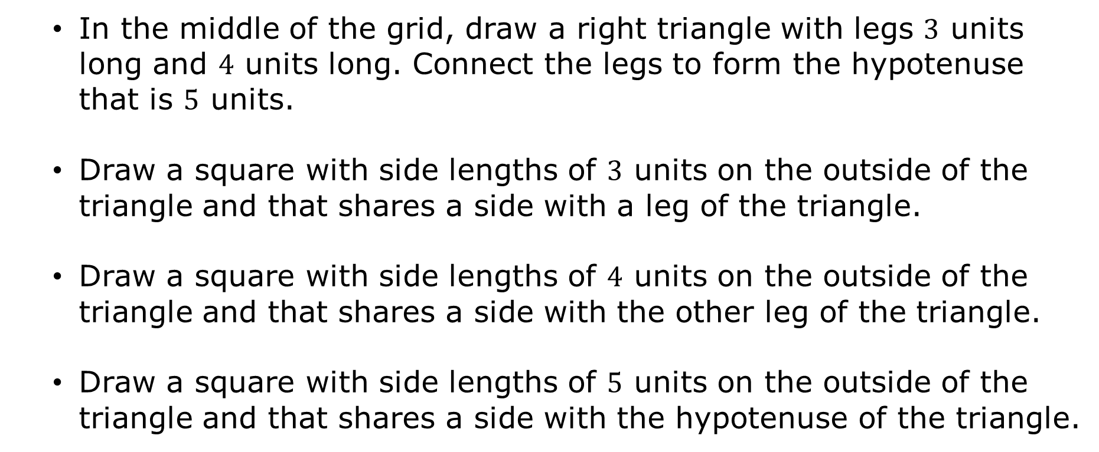
In the middle of the grid, draw a right triangle with legs $3$ units long and $4$ units long. Connect the legs to form the hypotenuse that is $5$ units.
Draw a square with side lengths of $3$ units on the outside of the triangle and that shares a side with a leg of the triangle.
Draw a square with side lengths of $4$ units on the outside of the triangle and that shares a side with the other leg of the triangle.
Draw a square with side lengths of $5$ units on the outside of the triangle and that shares a side with the hypotenuse of the triangle.
volume 1, pg. 192

Slide 15

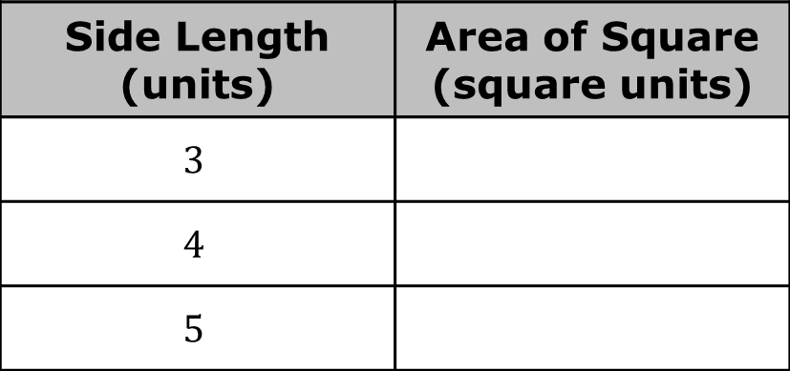
Complete the table with the area of each square.
Complete the comparison for the sum of the areas of the squared legs to the square of the hypotenuse.
$$3^{2}+4^{2} ⃞ 5^{2}$$
Side Length (units) | Area of Square (square units)
$$3$$
$$4$$
$$5$$
volume 1, pg. 192

Slide 16

Collaboration
volume 1, pg. 193

Slide 17

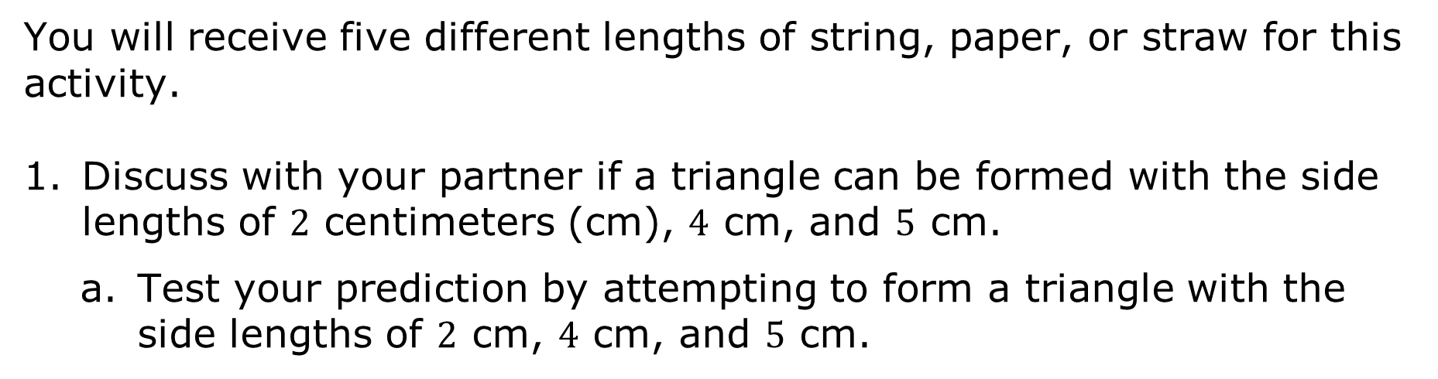
5.4.4 Collaboration: The Triangle Inequality Theorem and the Converse of the Pythagorean Theorem
You will receive five different lengths of string, paper, or straw for this activity.
Discuss with your partner if a triangle can be formed with the side lengths of $2$ centimeters (cm), 4 cm, and $5$ cm.
Test your prediction by attempting to form a triangle with the side lengths of $2$ cm, $4$ cm, and $5$ cm.
volume 1, pg. 193

Slide 18
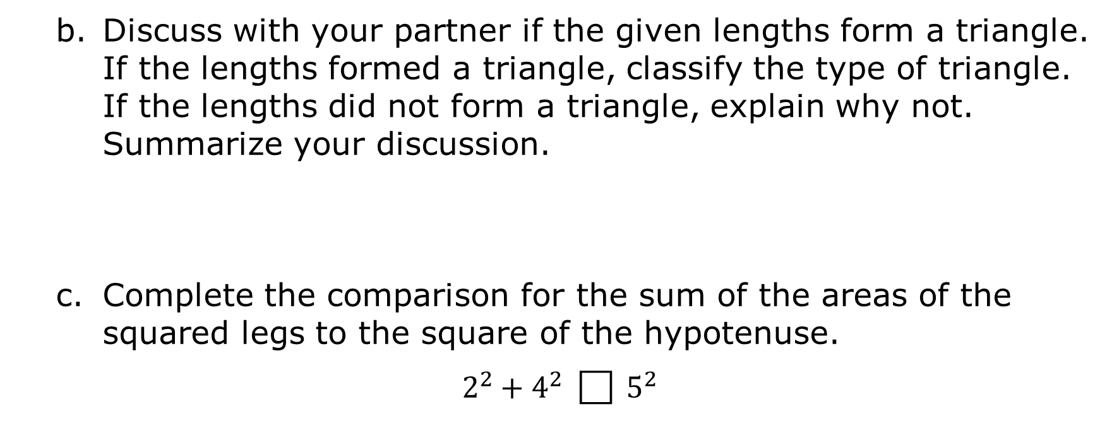
Discuss with your partner if the given lengths form a triangle. If the lengths formed a triangle, classify the type of triangle. If the lengths did not form a triangle, explain why not. Summarize your discussion.
Complete the comparison for the sum of the areas of the squared legs to the square of the hypotenuse.
$$2^{2}+4^{2} ⃞ 5^{2}$$
volume 1, pg. 193

Slide 19
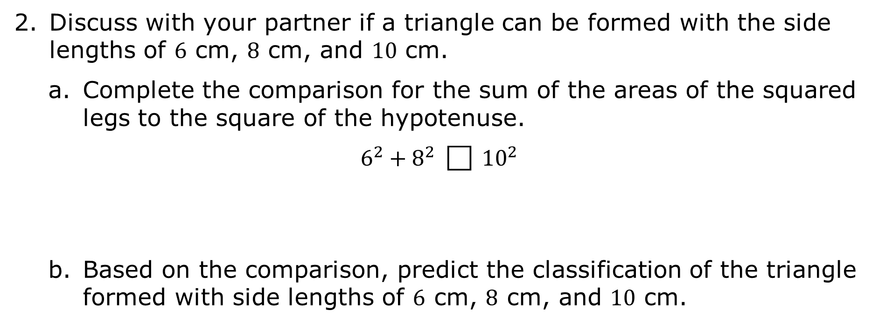
Discuss with your partner if a triangle can be formed with the side lengths of $6$ cm, 8 cm, and $10$ cm.
Complete the comparison for the sum of the areas of the squared legs to the square of the hypotenuse.
$$6^{2}+8^{2} ⃞ {10}^{2}$$
Based on the comparison, predict the classification of the triangle formed with side lengths of $6$ cm, $8$ cm, and $10$ cm.
volume 1, pg. 193

Slide 20

Sketch a triangle with side lengths of $6$ cm, $8$ cm, and $10$ cm.
What is the classification the triangle formed?
volume 1, pg. 193

Slide 21

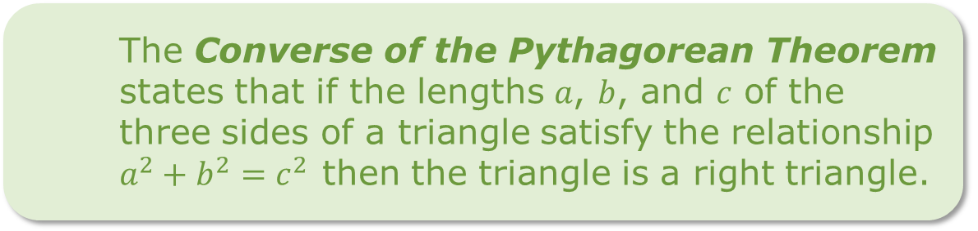
Discuss with your partner whether your prediction was correct or incorrect. Include how the comparison of the square of the legs to the square of the hypotenuse helped with your prediction. Summarize your discussion.
The Converse of the Pythagorean Theorem states that if the lengths 𝑎, 𝑏, and 𝑐 of the three sides of a triangle satisfy the relationship $a^{2}+b^{2}=c^{2}$ then the triangle is a right triangle.
volume 1, pg. 194

Slide 22

Your Turn
volume 1, pg. 194

Slide 23
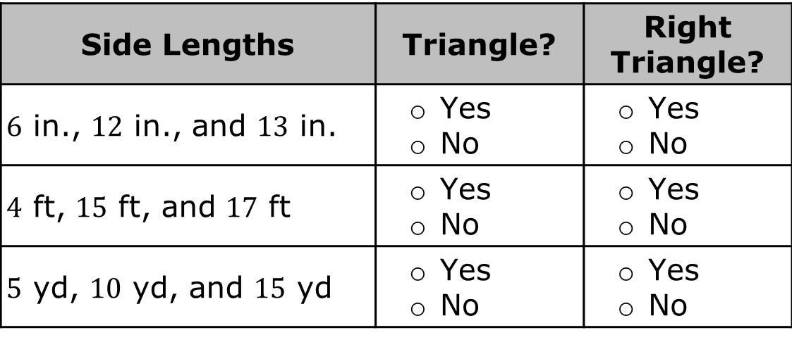
5.4.5 Your Turn!
Determine if each set of side lengths form a triangle. If the side lengths form a triangle, determine if it is a right triangle.
Side Lengths | Triangle? | Right Triangle?
$6$ in., $12$ in., and $13$ in. | Yes No | Yes No
$4$ ft, $15$ ft, and $17$ ft | Yes No | Yes No
$5$ yd, $10$ yd, and $15$ yd | Yes No | Yes No
volume 1, pg. 194

Slide 24
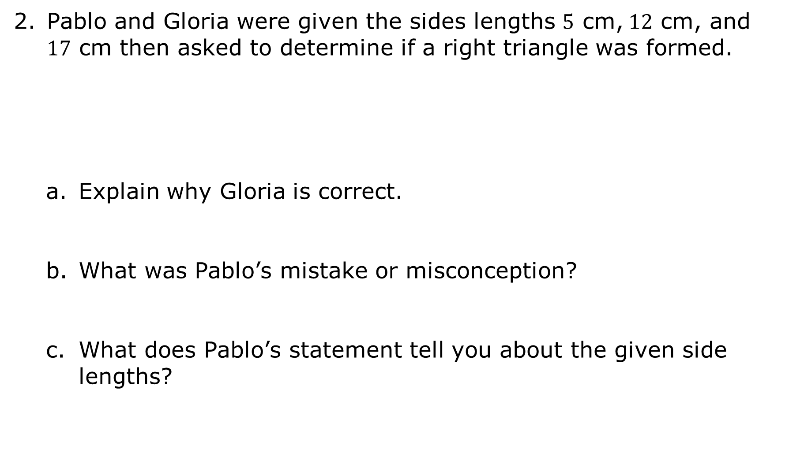
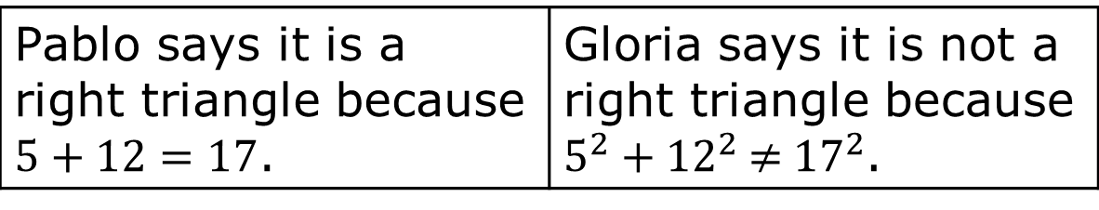
Pablo and Gloria were given the sides lengths $5$ cm,$12$ cm, and $17$ cm then asked to determine if a right triangle was formed.
Explain why Gloria is correct.
What was Pablo’s mistake or misconception?
What does Pablo’s statement tell you about the given side lengths?
Pablo says it is a right triangle because $5+12=17$. | Gloria says it is not a right triangle because $5^{2}$ + ${12}^{2}$ ≠ ${17}^{2}$.
volume 1, pg. 195

Slide 25

Wrap-Up
volume 1, pg. 195

Slide 26
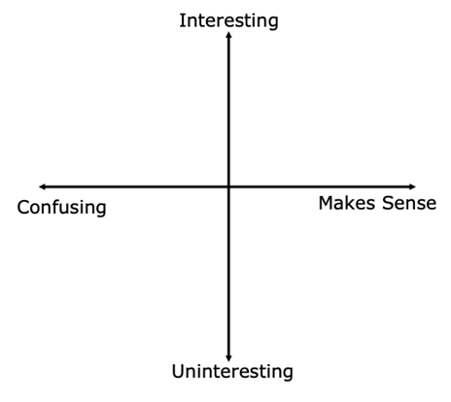
5.4.6 Wrap-Up: Reflection
Plot a point on the grid below to indicate your level of interest for today’s learning target.
volume 1, pg. 195

